Slide 1
Introduction
The movie rental business is a service industry where customers rent movies for a limited period instead of purchasing them. In the past, customers visited physical stores to rent DVDs, making it important for businesses to manage inventory, customers, and payments efficiently.
The Sakila DVD Rental Database represents a real-world movie rental system. It includes information about films, customers, rentals, payments, staff, and stores. This data helps in understanding how the business operates on a daily basis.
With the help of Power BI, this project transforms raw data into meaningful insights. It helps in analyzing customer behavior, identifying popular movies, tracking revenue, and evaluating staff performance.
Overall, the dashboard supports better decision-making and helps improve business efficiency and customer satisfaction.

Slide 2
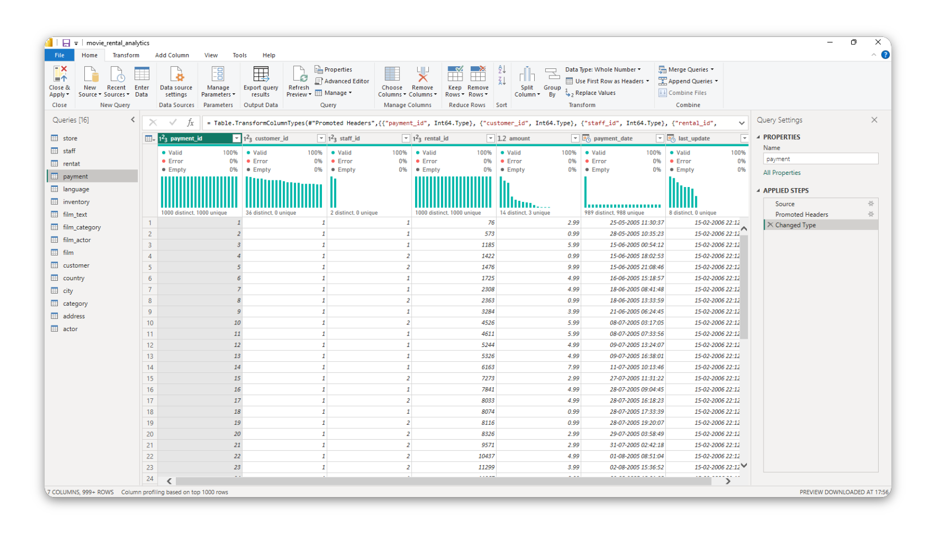
Data Cleaning and Preparation

Slide 3
Data Cleaning and Preparation
In this project, I performed data cleaning and preparation on the Movie Rental Analytics dataset using Microsoft Power BI, specifically through the Power Query Editor. The main objective was to transform raw data into a clean and structured format suitable for analysis. I focused on the payment table, which contains important transactional details such as payment_id, customer_id, staff_id, rental_id, amount, payment_date, and last_update.The first step involved importing the dataset into Power BI and opening it in Power Query Editor. I then applied the “Promoted Headers” operation to convert the first row into proper column names, ensuring better readability and structure. After that, I performed data type transformations, where numeric fields like IDs were converted into whole numbers, the amount column into decimal format, and date fields into proper date/time format. This step is crucial to maintain consistency and avoid errors during analysis.Next, I conducted data quality checks using column profiling features. I verified that all columns contained 100% valid values, with no null (missing) values or errors. I also analyzed the distribution of data in each column, ensuring that the payment_id field contains unique values (serving as a primary key), while other fields like customer_id appropriately contain repeated values representing multiple transactions.As a result of these cleaning steps, the dataset became accurate, consistent, and analysis-ready. This process improved data reliability and ensured that further visualization and reporting would produce meaningful insights. Overall, data cleaning in Power Query plays a vital role in preparing high-quality data for effective decision-making

Slide 4
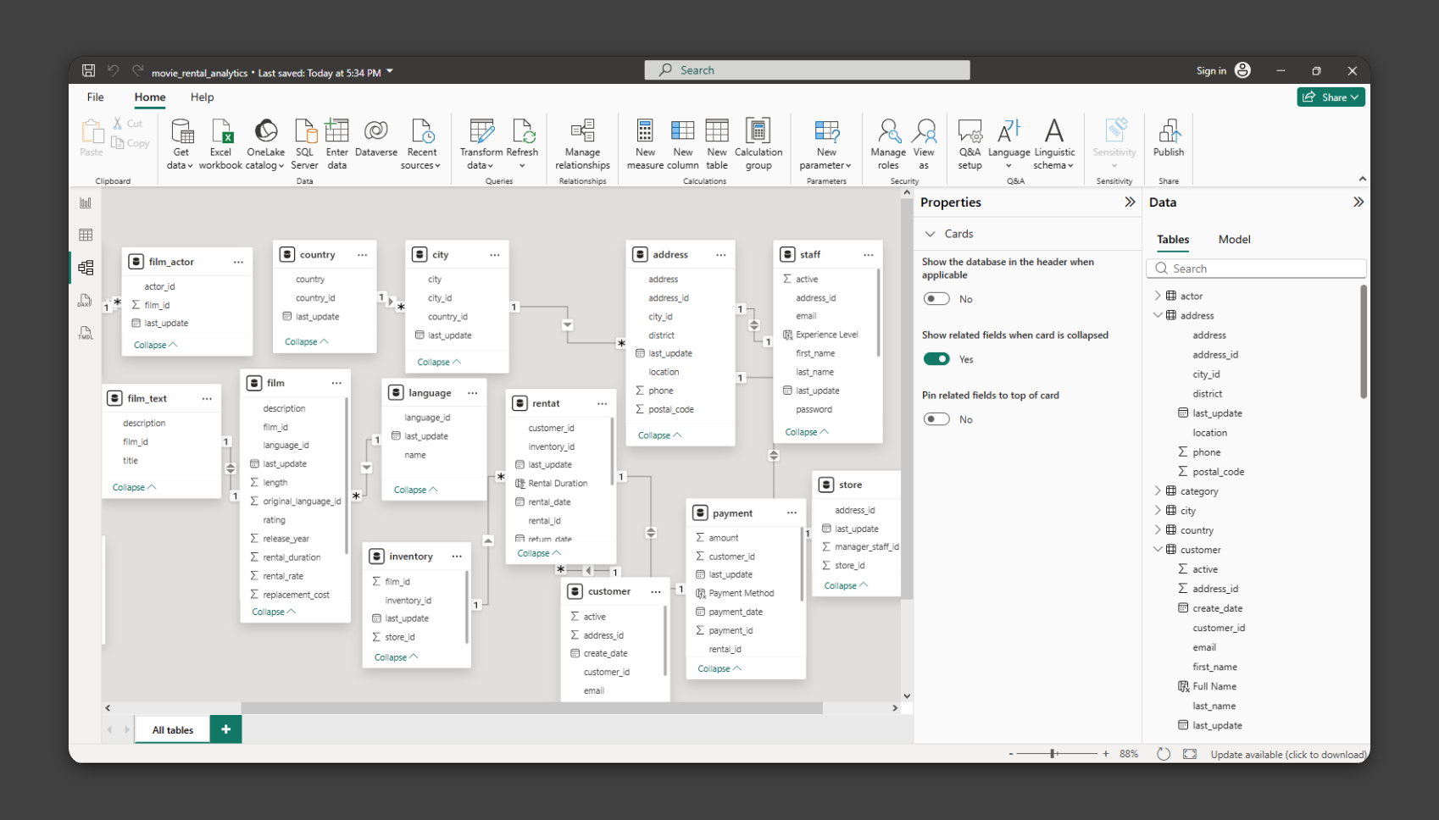
Data model (er diagram)

Slide 5
Data model (er diagram)
After cleaning, I moved to the data modeling stage, where multiple tables such as actor, film, customer, rental, payment, staff, store, address, city, and country were connected. Relationships were created between these tables using primary and foreign keys. For example, the customer table is linked to the payment and rental tables, the film table is connected to inventory and category tables, and location-related tables like city and country are connected through address. These relationships form a relational data model, allowing data to flow across tables. The model follows a structured schema where one-to-many relationships are established, ensuring efficient data organization and reducing redundancy. This setup enables accurate analysis, such as tracking customer payments, rental history, and film categories. In conclusion, data cleaning ensured high-quality data, while data modeling created meaningful relationships between tables. Together, these steps made the dataset fully prepared for visualization, reporting, and generating business insights.

Slide 6
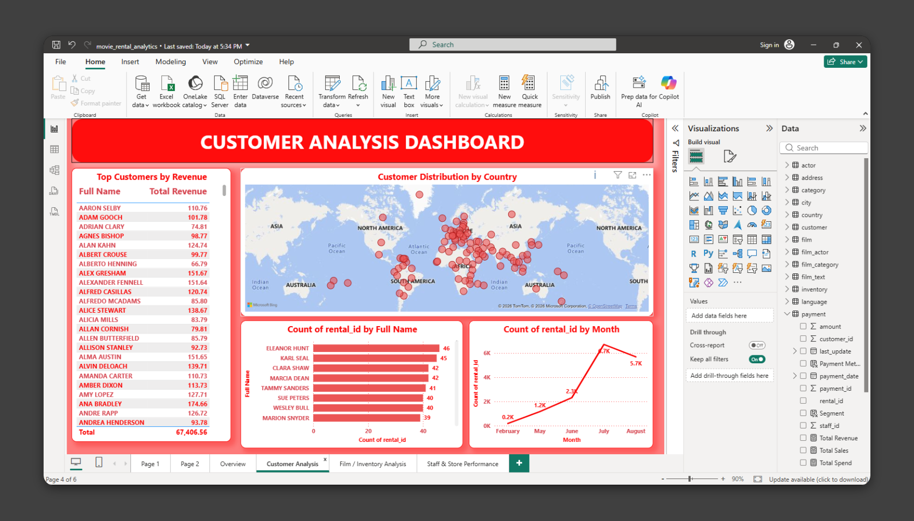
CUSTOMER ANALYSIS DASHBOARD
In this project, I created an interactive Customer Analysis Dashboard using Microsoft Power BI to analyze customer behavior and revenue patterns in the Movie Rental Analytics dataset. After completing data cleaning and data modeling, I developed this dashboard to present insights in a visual and easy-to-understand format. The dashboard includes multiple visualizations. On the left side, a table of Top Customers by Revenue displays customer names along with their total revenue contribution. This helps identify the most valuable customers for the business. At the center, a world map visualization shows the customer distribution by country, indicating where customers are located globally and highlighting regions with higher customer concentration. Additionally, a bar chart is used to represent the count of rentals by customer name, showing which customers have rented the most movies. This helps in understanding customer engagement and activity levels. A line chart is also included to display the count of rentals by month, which helps identify trends and seasonal patterns in customer rentals over time. The dashboard is designed with a clear layout and visual hierarchy, making it easy to interpret key metrics quickly. It enables better decision-making by providing insights into customer performance, geographic distribution, and rental trends. In conclusion, this dashboard effectively transforms raw data into meaningful insights, helping businesses understand their customers and improve strategies for growth and customer retention.

Slide 7
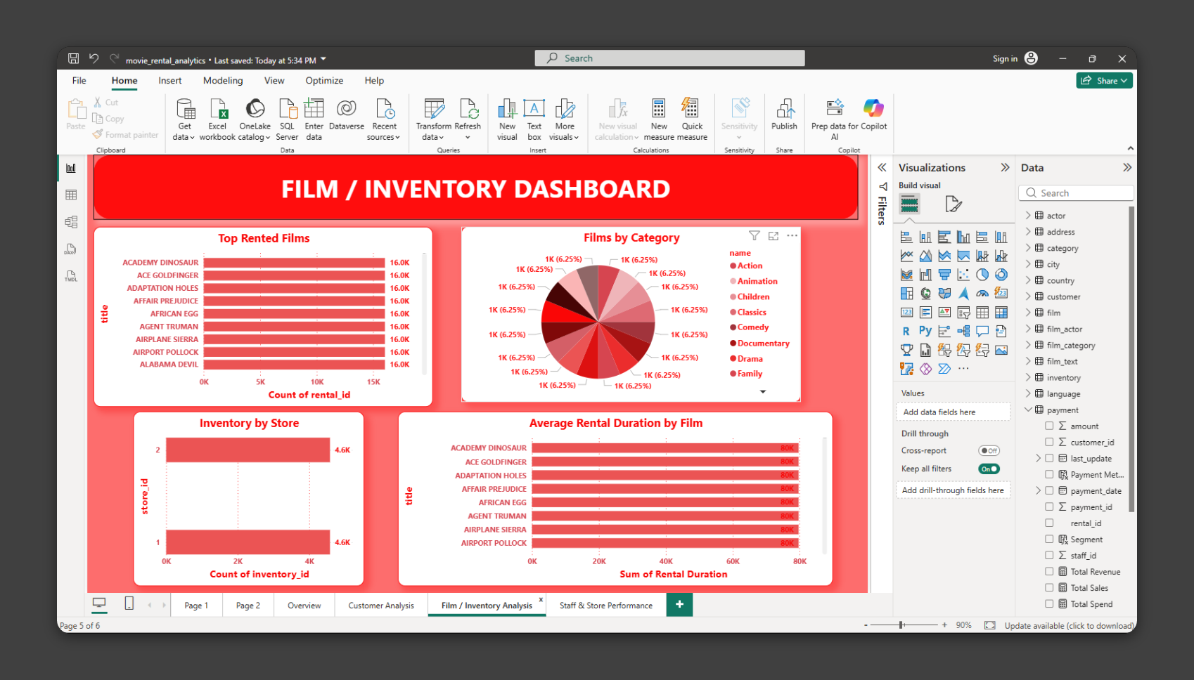
FILM / INVENTORY DASHBOARD
In this project, I created a Film / Inventory Dashboard using Power BI to analyze movie rental data. The main objective was to understand customer behavior, identify popular films, and evaluate inventory distribution across stores. The dashboard consists of multiple visualizations. The Top Rented Films section displays the most frequently rented movies, such as Academy Dinosaur and Ace Goldfinger, each having high rental counts. This helps in identifying the most popular films among customers. The Films by Category section uses a pie chart to show the distribution of movies across different genres like Action, Comedy, Drama, and Family. This helps in understanding the variety and balance of film categories available in the inventory. The Inventory by Store chart compares the number of films available in different stores. It shows that both stores have nearly equal inventory, which indicates proper stock management and distribution. The Average Rental Duration by Film section shows how long customers keep movies on rent. This helps in analyzing customer viewing patterns and identifying films that are retained longer. Overall, this dashboard provides clear insights into rental trends, inventory management, and customer preferences. It helps businesses make better decisions regarding stock management, movie demand, and customer behavior.

Slide 8
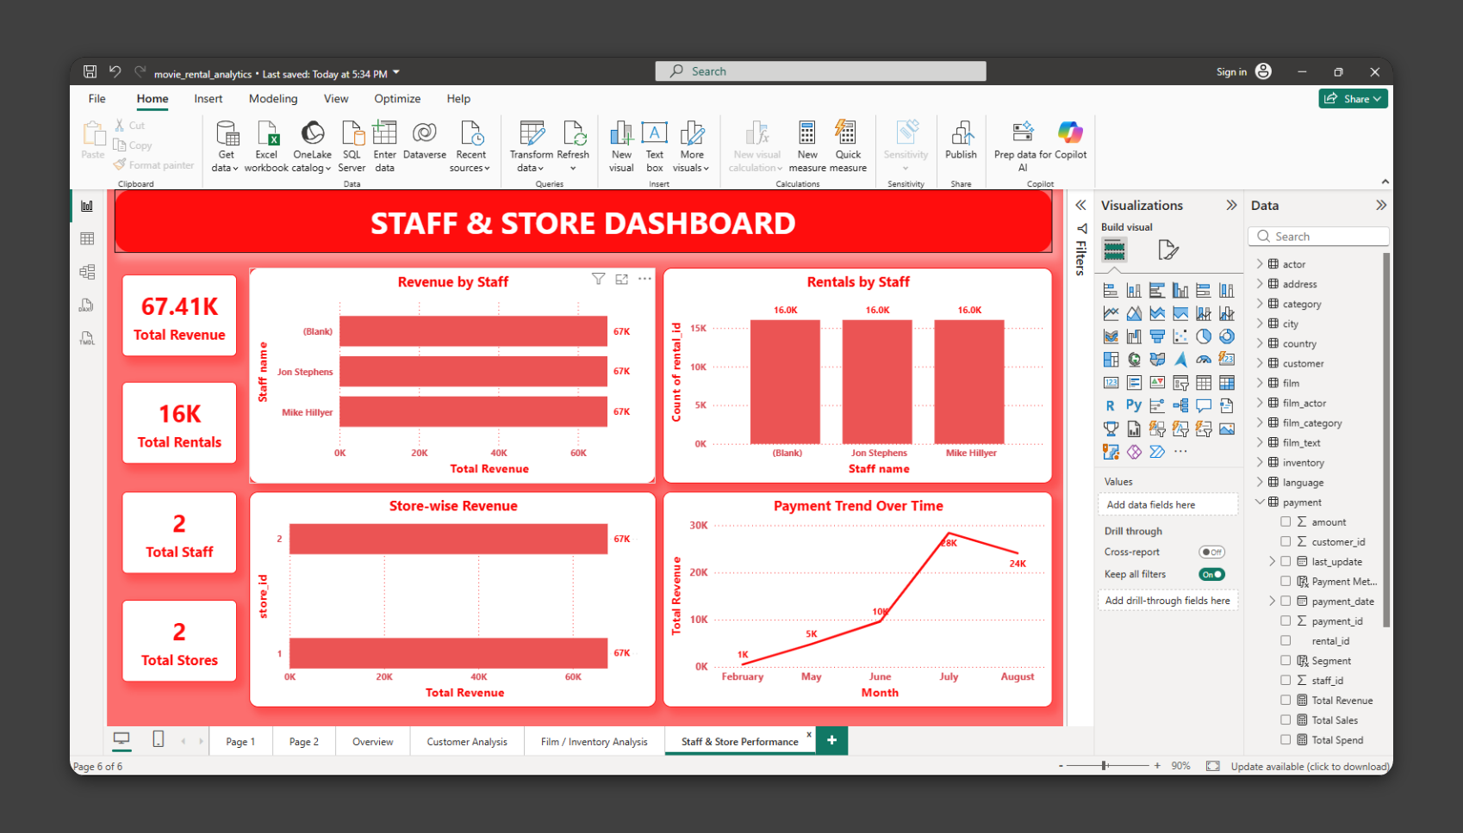
STAFF & STORE DASHBOARD
In this part of the project, I created a Staff & Store Dashboard using Power BI to analyze the performance of staff members and store operations. The goal was to evaluate revenue generation, rental activity, and overall business performance. The dashboard displays key performance indicators such as Total Revenue (67.41K), Total Rentals (16K), Total Staff (2), and Total Stores (2). These KPIs provide a quick overview of the business performance. The Revenue by Staff chart shows how much revenue each staff member has generated. It helps in comparing staff performance and identifying top contributors. Similarly, the Rentals by Staff chart displays the number of rentals handled by each staff member, giving insight into their workload and efficiency. The Store-wise Revenue section compares revenue generated by different stores. Both stores show nearly equal revenue, indicating balanced performance and proper management across locations. The Payment Trend Over Time graph shows how revenue changes over different months. It indicates growth in revenue from February to July, followed by a slight decline in August. This helps in understanding seasonal trends and business patterns. Overall, this dashboard provides valuable insights into staff efficiency, store performance, and revenue trends. It helps management make informed decisions to improve productivity and business growth.

Slide 9
Summary of Analysis
The analysis of all dashboards provides important insights into the movie rental business. The data shows that certain films are rented more frequently, indicating customer preferences and popular content. The category distribution suggests a balanced variety of genres available in the inventory. The inventory is equally distributed across both stores, which reflects efficient stock management. The rental duration analysis shows that some movies are kept longer by customers, helping understand viewing behavior. From the staff and store perspective, revenue and rental counts are almost evenly shared between staff members and stores, indicating balanced performance. The payment trend shows an increase in revenue over time, with a peak in mid-year, followed by a slight decline, highlighting seasonal trends.

